Slide 1
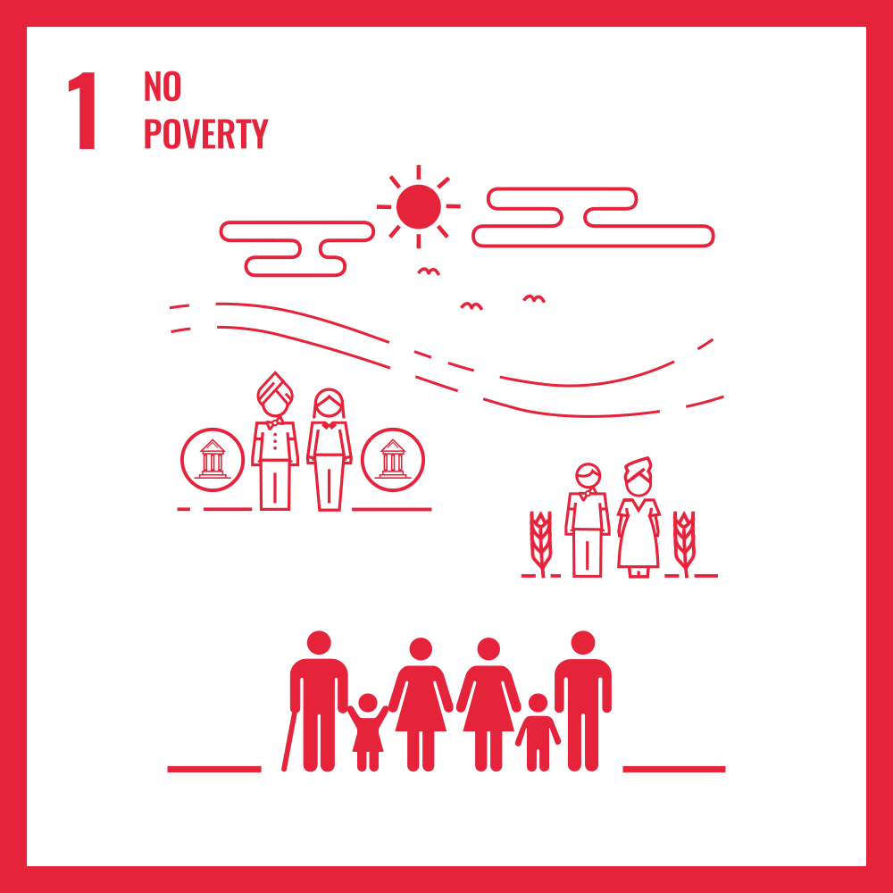
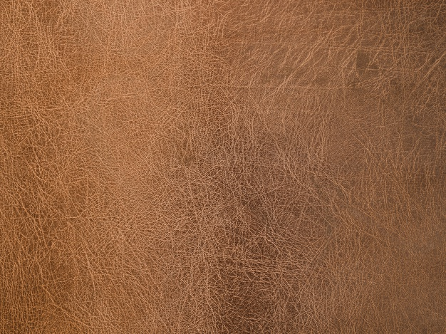
HUM1039 – CDP
Review 3
Decreasing Poverty among Rural Communities
20BCE1630 – Mohamed Ashraf Ali 20BCE1689 – Hrithik D
20BCE1852 – Devarinti Dhapatla Puneeth Reddy
20BCE1855 – Sanjil K C
20BCE1892 – Lenin Vasan

Slide 2



Poverty is the major problem throughout India. It is said that around 20% of the people in India live in poverty. They do not even have most of the basic needs. People rely on public and government for any kind of minimum requirements. The below methodologies show how people can get enough income in order to live for their basic needs and can take them to a next level.
INTRODUCTION

Slide 3

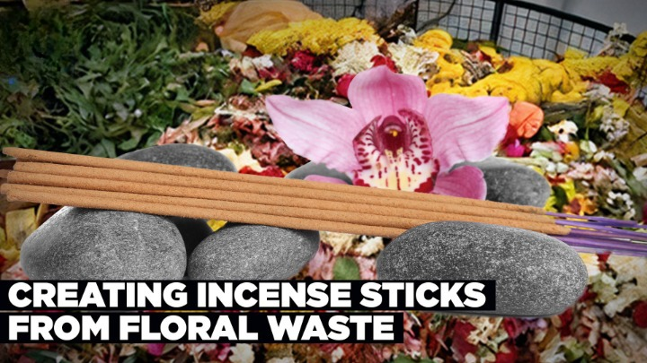
Incense sticks from Floral waste
To make one packet of incense stick we require nearly 1.25kg of floral waste. Based on this data in each facility if around 4000kgs of floral waste are collected then we would be producing nearly 3200 packets of incense sticks per day. If the rate is kept around 20rs per packet then for 3200 packets we can earn 64000rs, then on an average each person would get around 15000rs monthly income. Each facility consists of nearly 100 people.
It is estimated that two million tonnes of floral waste in India are discarded every day after religious ceremonies. Tamil Nadu, which has 38,000 temples under the Hindu Religious and Charitable Endowments (HR &CE) department alone, generates more than 3.8 lakh kilos of floral waste every day, according to a senior HR & CE official.
A GVMC (Greater Visakhapatnam Municipal Corporation) official said, “Floral waste is generated in every ward, depending upon the location of temples. Usually more than 1,000kgs of floral waste is generated per month. During festivals, it goes up to more than 2,000kgs.”
INCENSE STICKS
FROM FLORAL WASTE

Slide 4
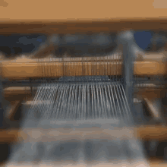
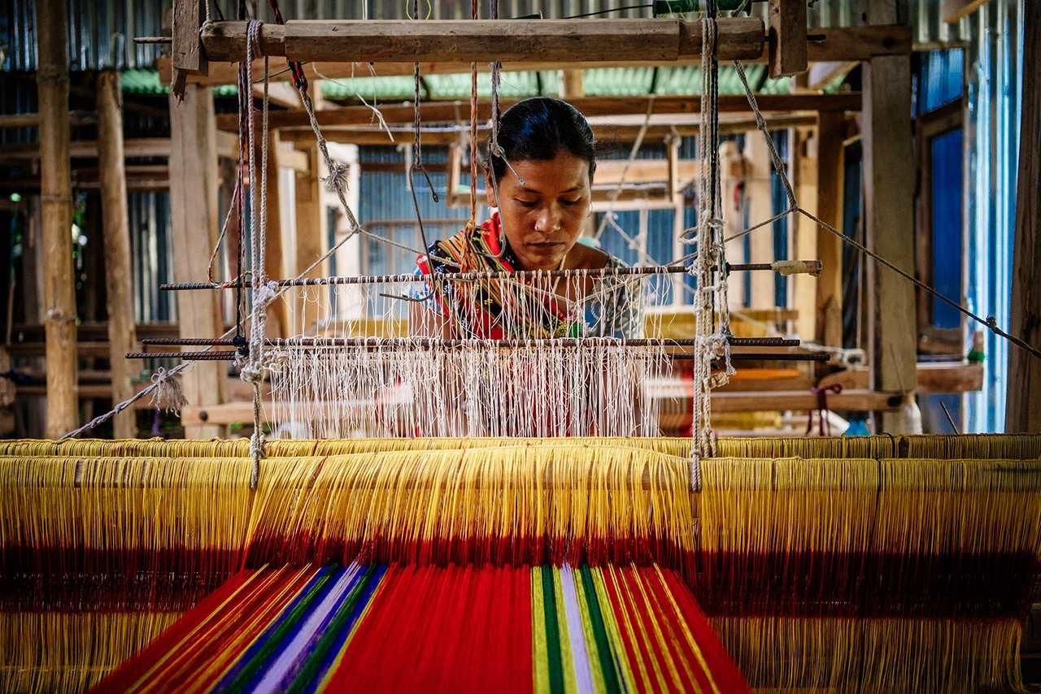
Weaving
Each blanket can be sold for 350rs, 80 blankets will be sold for 28000rs where 15000rs will go cotton yarn, the remaining will be 12500rs.
Tamil Nadu is the land in India with the largest cotton yield, which is approximately 1,214 kilograms per hectare. Ramanathapuram, Madurai, Salem, Coimbatore, and Tiruchirappalli are among one of the significant cotton manufacturing areas in Tamil Nadu.
From the 12500rs the monthly interest for handloom will be 2500rs for the first eighteen months for the commercial loan of handloom. After 18 months, each person would get 12500rs monthly income.
Handloom machines cost 20000rs, cotton yarn with dyeing 15000rs (every month)(75kg), handloom accessories 2000rs, maintenance 500rs(monthly). We will be producing nearly 80 single size blankets. Each person (one machine) should work 10 hrs per day. We can sale these blankets through online websites.
HANDLOOM
WEAVING

Slide 5

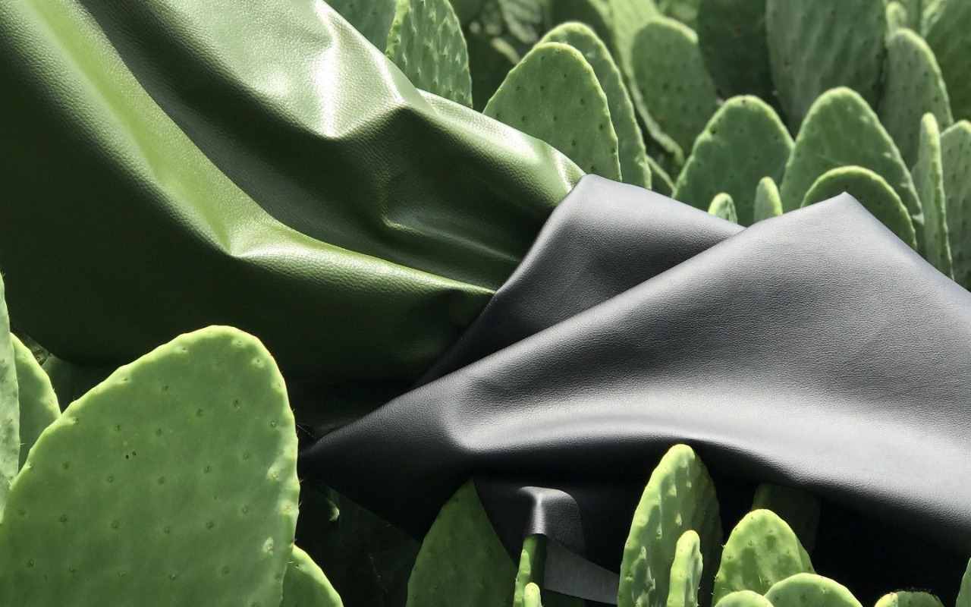
Vegan leather using Cacti
We can keep a tie-up with the desserto company who has the patent to produce vegan leather from cacti and can provide jobs from growing cacti to processing into leather in India. Or we can export the cacti from India to other countries which can manufacture vegan leather. For cultivation of cacti, we can use Tarisu lands of government with the permission of respected departments. In order to manufacture we can use Natham Poramboke lands with permissions.
In India, cacti are majorly grown in Gujarat and Rajasthan. Prickly Pear is also known as Nopal, Tuna in International markets. We can also harvest in any place required. Cacti can survive and flourish in desert conditions, so there is no need for irrigation systems, which significantly reduces its use of natural resources.
The nopal plant can survive with rainwater and can live at any temperatures, the harvest time will be 6-8 months. The leaves of the nopal plant are used for making leather. It takes approximately 3 leaves of cactus to create one linear meter of leather.
Each person can get a minimum monthly income of 15000rs. The material can be used in the application of upholstery, automotive, fashion, shoes, handbags and more.
VEGAN LEATHER
USING CACTI
These leaves are harvested from organically grown cactus plants, cleaned, mashed, and left in the sun to dry for three days before being processed, and then turn them into any texture or colour with non-toxic chemicals.

Slide 6
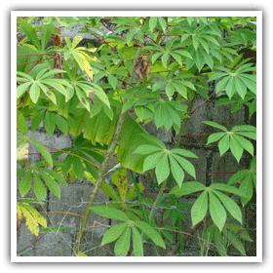
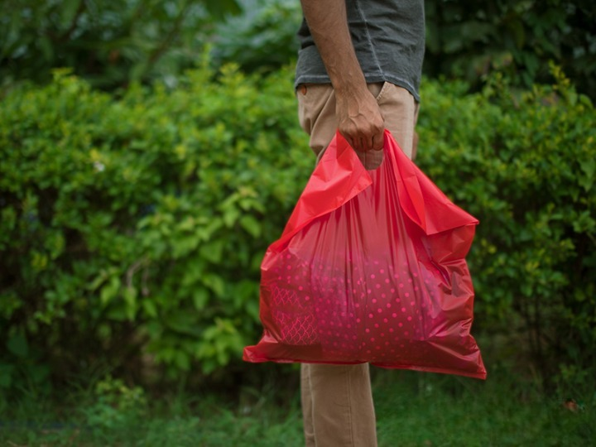
Tapioca
To prepare one bag we require 25g of tapioca starch. A major proportion of the leaf carbohydrate is starch. The amylose content of the leaf starch has been reported to range from 19-24 percent. The crude fibre content of cassava leaves is low which makes it palatable as poultry feed.
Three hybrids of tapioca are grown in Tamil Nadu, mainly for industrial purpose such as sago and starch, occupying more than 75 per cent of the total area in Salem, Dharmapuri, Namakkal and Erode districts.
Based on the above data we can provide jobs around the areas of Salem, Dharmapuri and Namakkal districts. The rate of Tapioca bags cost more than plastic bags and less than cloth bags. For 580rs, 200 bags are produced which means each bag costs 3rs.
TAPIOCA
BAGS

Slide 7
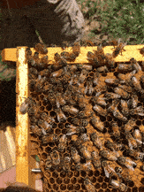
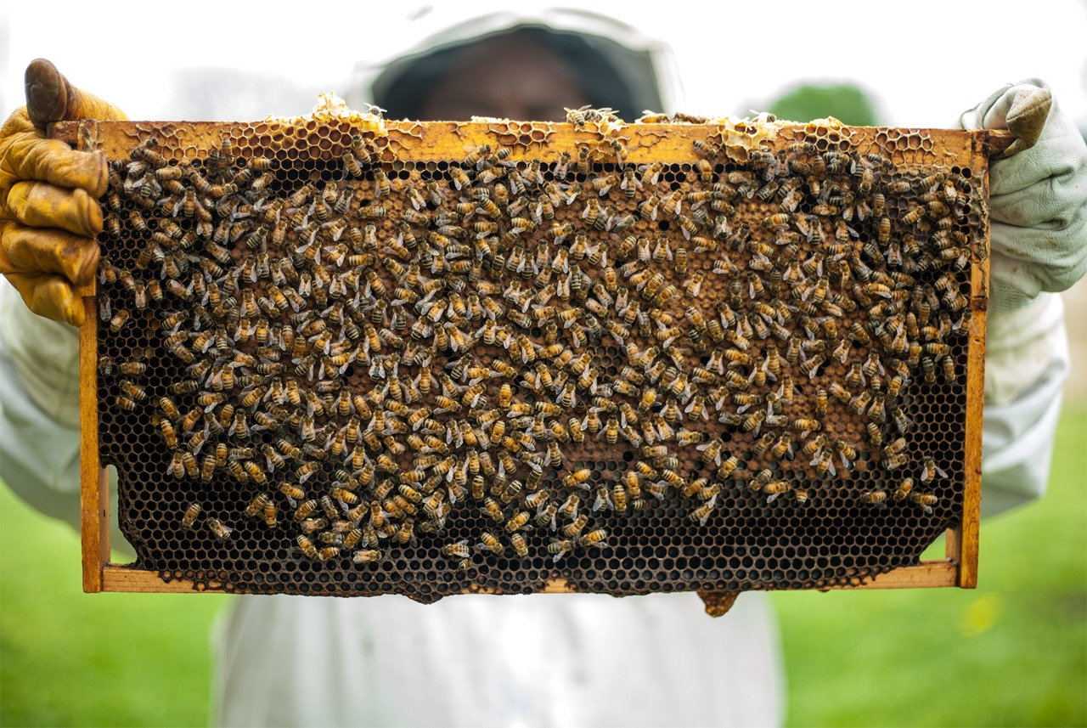
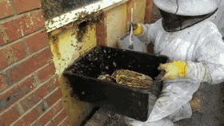
Apiculture
One beehive box costs 5000rs. One beehive box contains around 50000-60000 bees. One beehive box can produce 16-20kg of honey per month. One kg bottle of honey costs around 400rs. So, based on the above data if one person has 3 boxes, they can earn nearly 17000rs monthly even after other expenses.
The bees can be kept in any temperature regions but for the honey the surrounding must contain good number of flowers (agriculture lands, around mountain areas, private gardens, at house backyards).
The Basic Beekeeping Equipment are Hives, Frames and Protective clothing like bee suit, gloves and shoes. The cost of these basic beekeeping equipment 2000rs.
One person can manage up to 20 hives.
APICULRURE
HONEY

Slide 8
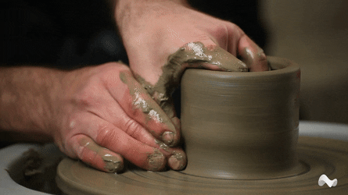
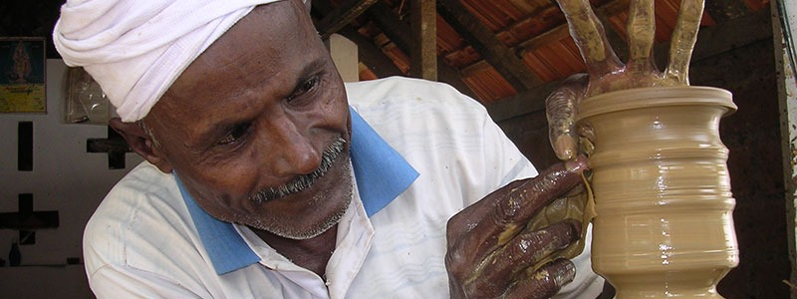
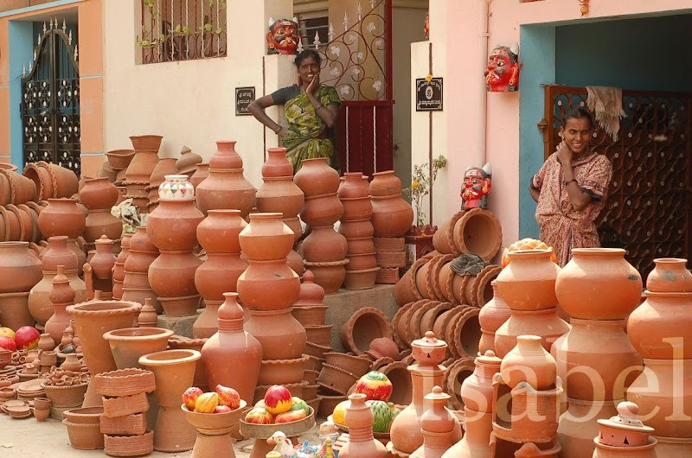
Pottery
On an average per month 800 pots can be prepared by 3 people per facility each of them would get 10000rs monthly income.
In Tamil Nadu, clays are found in Vellore district, of Kanchipuram district, Cuddalore district, Perambalur district, Thanjavur district, Kanniyakumari district, Tirunelveli district, Ariyalur district. Clays are used as soft abrasives for polishing soft metals, uniform buttons, belts etc, for buffing ceramic goods.
The Materials Required are Sculpting Tool Set, Self-Hardening Clay, Pottery Wheel, Glazing Brushes, Clay Cutters, Wire Clay Cutters, Sponge
POTTERY
POTS

Slide 9
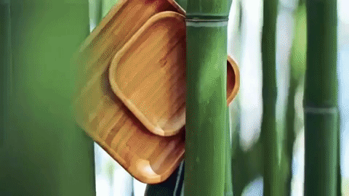
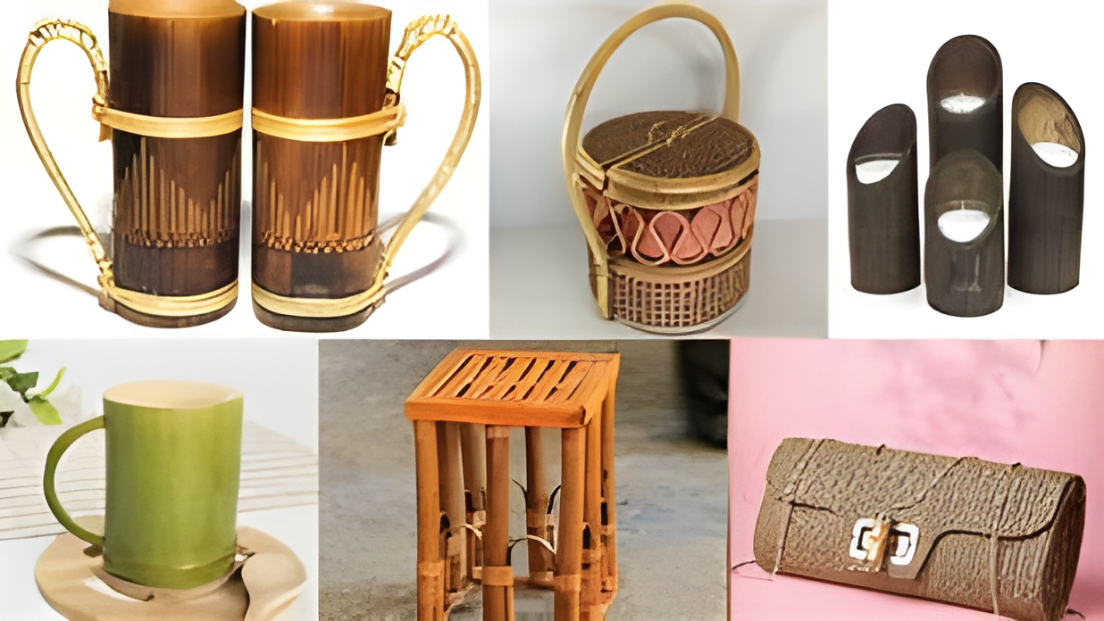
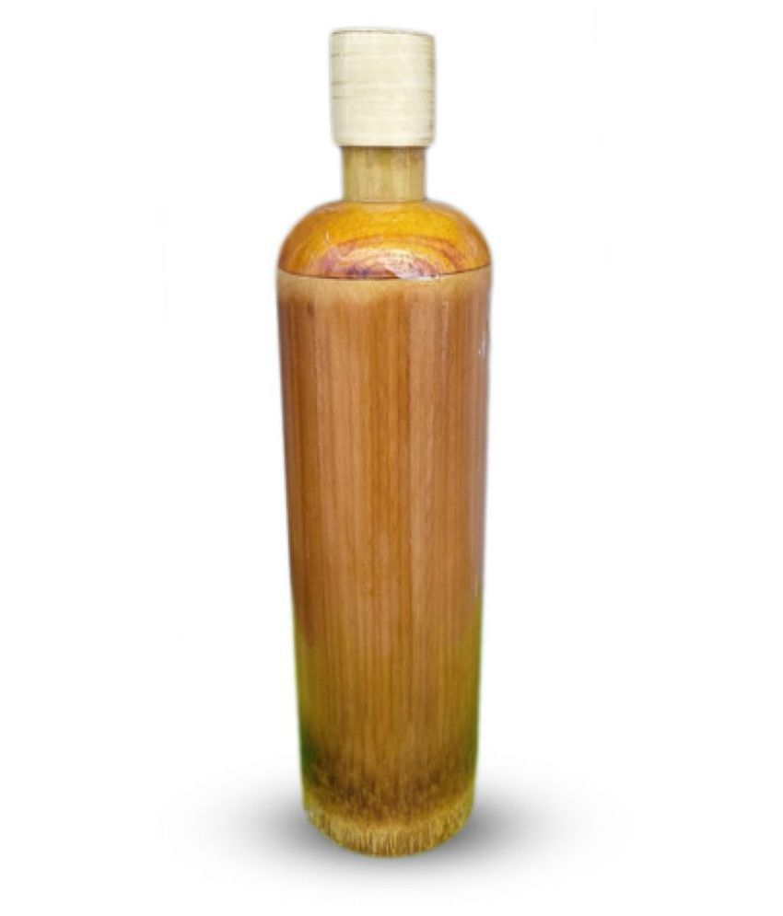
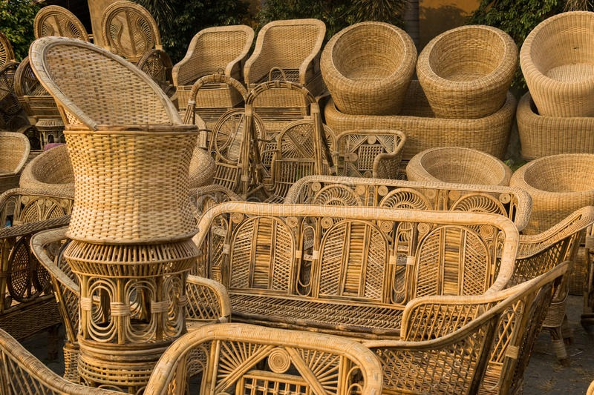
Bamboo handicrafts
Based on the above products made and sold we can give 15000rs per person. The market demand has increased for such products for its eco-friendly nature. These days bamboo products are used for many various purposes especially furniture and gift items like in restaurants.
For each facility we can keep 5-10 people. Other than bamboo we require materials for handicrafts like Thread, Natural colours and Boric and Borax Powder. The tools required are knives, tape, hand cutter, saw and other instruments. We might require an investment of 10000rs per facility.
We can prepare water bottles, bird nests, toys, toothbrush, furniture, kitchen appliances, household appliances. Then the products will be sold through online websites.
HANDICRAFTS
BAMBOO
This helps us in reducing the usage of plastic items. Bamboo handicrafts can be the best alternate for plastic substances.

Slide 10
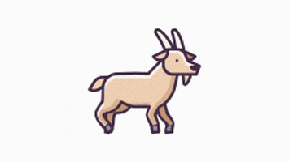
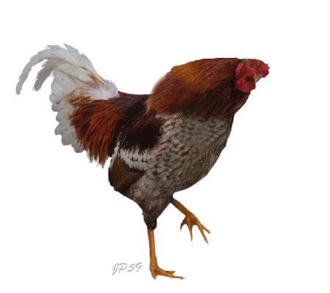
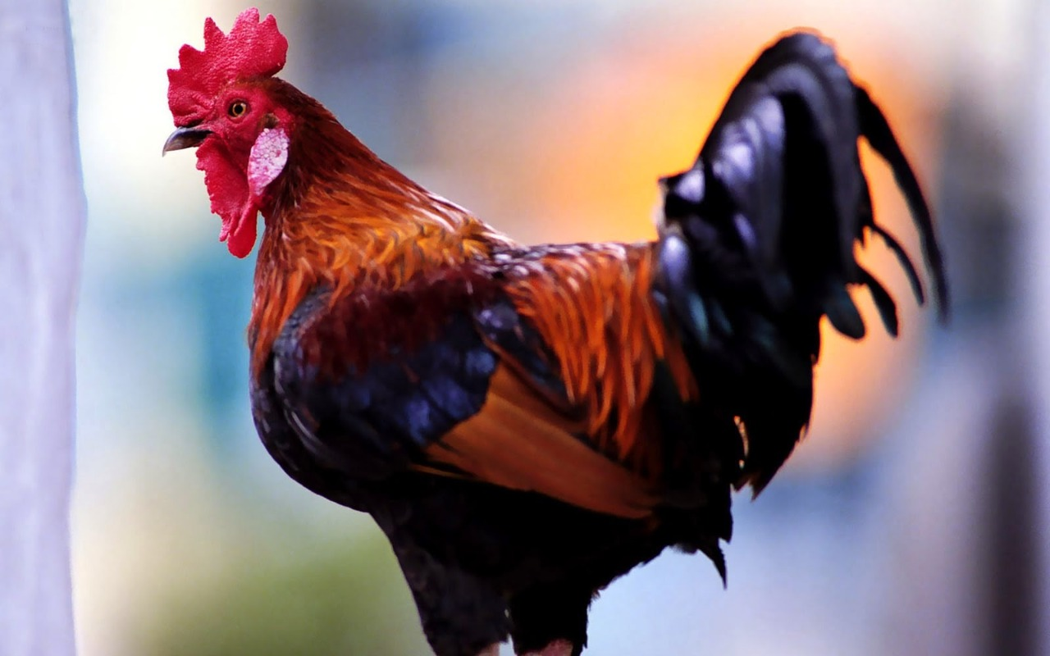
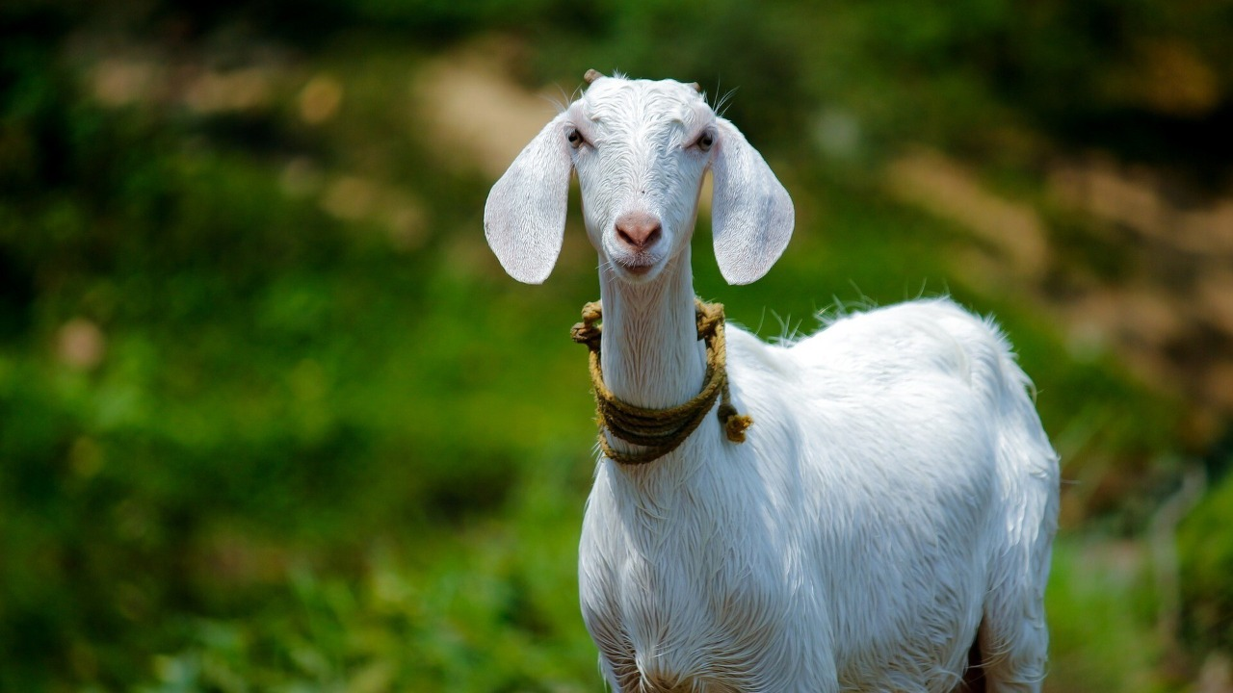
Providing small cattle animals – Goat
Providing small cattle animals – Hen
If we invest 20000rs for buying 1 male and 4 female, in 2 years of time we will get 24 babies on an average we can earn 96000rs and also sell the parents for 50000rs. Then to make a rotation and considering expenses we will get a monthly income of 5000rs for 2 years.
If we invest 2400rs to buy 60 chicks, after 6 months of growth each would acquire 1.5kg of weight and can be sold and the eggs laid also can be sold. Considering the expenses and deaths we would get a monthly income of 4000rs.
GOAT
HEN

Slide 11
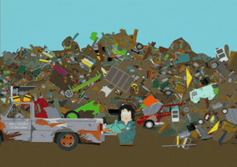
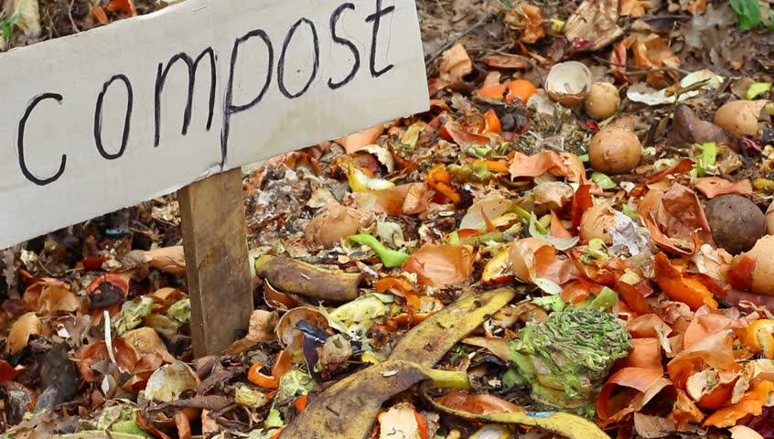
Biodegradable waste collection – for making organic fertilizer
Mumbai generates about 5000 tons of biodegradable waste per day. Chennai generates about 3800 tons of biodegradable waste per day. If 1.5 tons of biodegradable waste are collected per day (45 tons per month), then per month around 6.5 tons of compost can be prepared.
Every year, 2.01 billion tons of municipal waste is generated. India produces 277 million tons of municipal solid waste every year, according to a 2016 estimate. In India, 77% of waste is disposed of in open dumps, 18% is composted and just 5% is recycled.
One kg of compost can cost around 300rs. So, based on the above production each person can earn up to 15000 per month.
BIODEGRADABLE WASTE
ORGANIC FERTILIZER
We can compost the biodegradable waste which goes to the landfill through Aerated (Turned) Windrow Composting and Vermicomposting. We can employee up to 20 people per facility.

Slide 12

The products produced by people can be sold through online e-commerce websites with the support of government in order to help the people who live in poverty. People can also contact them directly to buy these products.
The whole project is about providing jobs to people in order to attain their basic requirements like food, shelter, education, health care and such. We have successfully completed that. This would more helpful to people rather the subsidies provided so that the people can move to next level of their lives, the next aim would be to go to another higher level.
CONCLUSION

Slide 13



